Slide 1

DEVELOPERS SOCIETY
WEB WORKSHOP

Slide 2
Agenda
Today we’re going to be going over the architecture of modern web-apps!
First, we’ll get an understanding of how the web works, and explore the different parts of web systems.
Then we’ll create a web-app of our own from scratch!

Slide 3



What is the web?
The web is a collection of connected systems, exchanging data between themselves. Most modern websites consist of three tiers: Client, Server, and Database.
Client
Application Server
Database

Slide 4

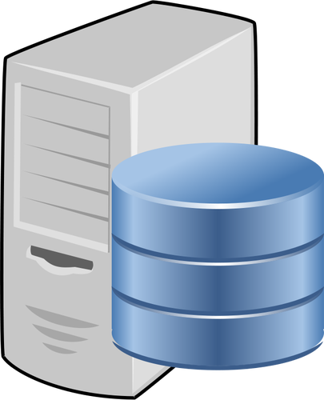

Separation of Concerns
By storing the data in the back-end separately from your front-end, you can access it from different clients.
Frontend(s)
Backend
Notes:
Basically explaining how you don’t need to distribute data to different clients, but can rather store it in a centralised location and just request it from there. Also explain: Allows for our applications to be modular, More degrees of freedom when it comes to testing, deployment, etc., Easier to scale

Slide 5
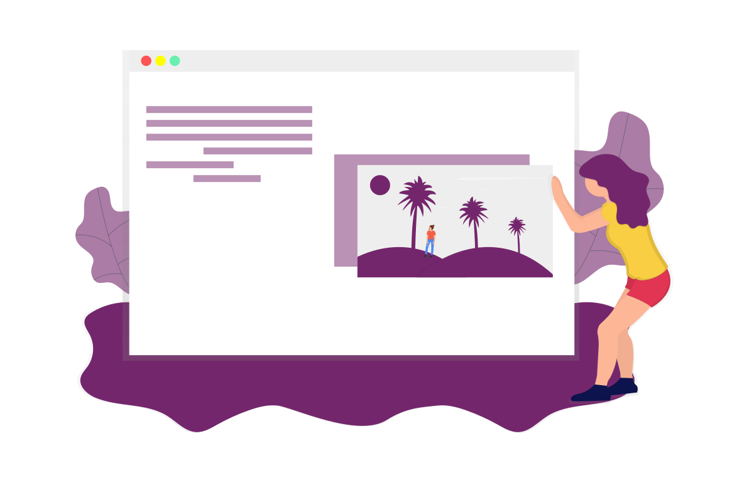
Front-end
The front-end is the part of your application that a user sees and interacts with directly. You can have multiple different front-ends, such as mobile apps, websites, etc. The front-end is responsible for displaying data stored in the back-end to users.
We will be focusing on web-based front-ends

Slide 6
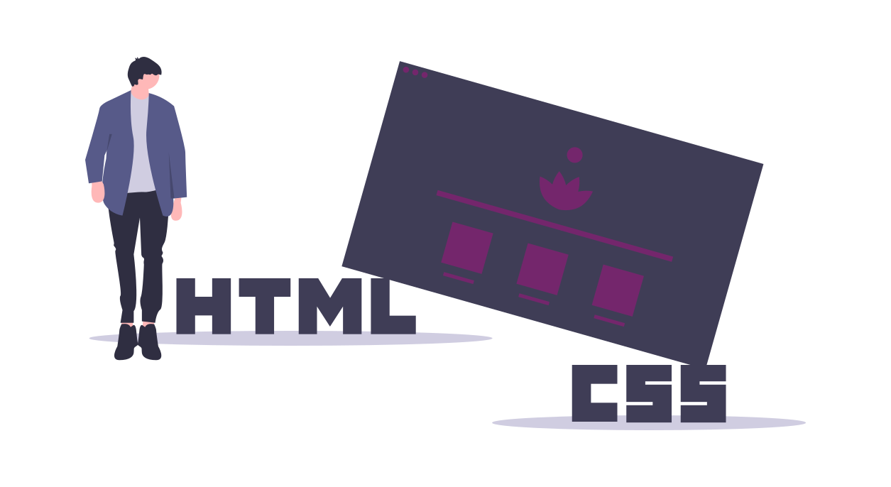
Front-end Technologies
There are many different technologies for creating a web-based front-end, such as vanilla HTML/CSS/JavaScript, Frameworks (e.g. React, Angular), Server-side Rendering etc.
We’re going to keep it simple, and use vanilla HTML/CSS/JS

Slide 7
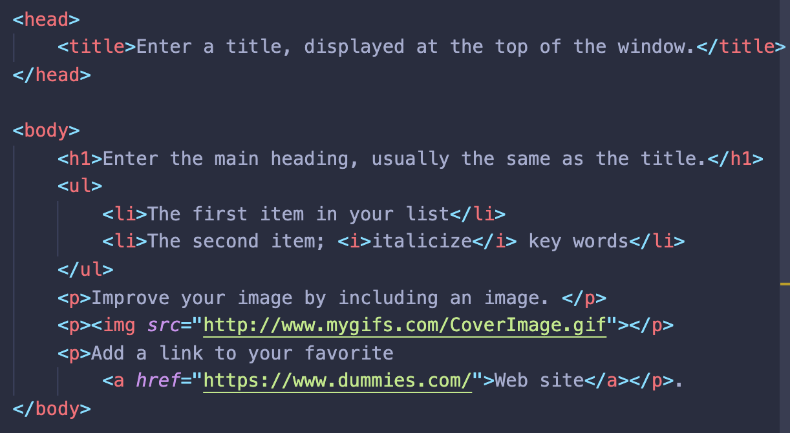
Front-end - HTML
HTML, or HyperText Markup Language is a markup language that allows us to specify the layout of our web pages.
It allows us to define all the elements of our page, such as text, images, buttons etc.

Slide 8
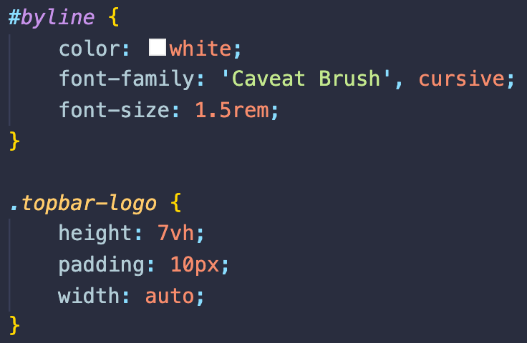
Front-end - CSS
CSS, or Cascading Style Sheets, work with HTML to allow us to easily style and design our websites
It allows us to define rules about how the elements on our webpage look and behave (e.g. their size, position, colour, etc.)

Slide 9
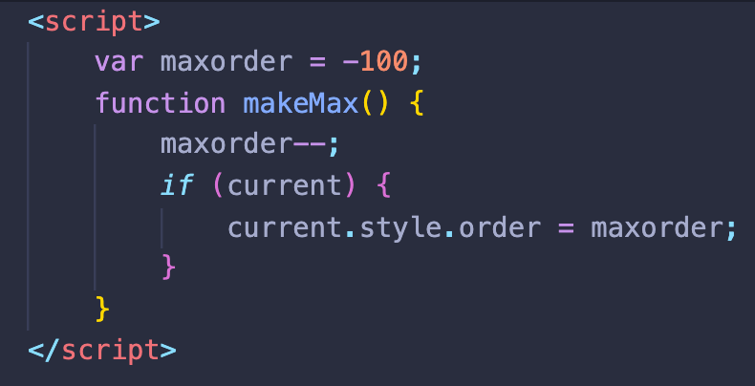
Front-end - JavaScript
JavaScript is a programming language that allows us to define the logic of our website.
It makes web pages dynamic and interactive (e.g. do something when the user clicks a button).
The reason modern websites are more applications than they are simply sites

Slide 10




Front-end Overall
HTML
We can think of the front-end like the human body:
HTML - Skeletal system CSS - Skin, Hair, etc. JavaScript - Nervous system, muscles
CSS
JavaScript

Slide 11
Back-end
The back-end is the complement to the front-end - everything the user doesn’t see. It is concerned with the implementation of business logic, and data manipulation.
Business logic is just server-side code that makes things happen.
Data manipulation involves CRUD operations (create, read, update, delete) in some kind of data storage (e.g. a database)
In three-tier architectures, the back-end consists of an application server and a database.

Slide 12
Back-end - Business Logic
You can use anything! Almost every language can be used for back-end development (Java, C, Python, JavaScript, Go, Rust….)
Sometimes you have more than one backend service that have their own responsibilities (see: separation of concerns), and each can use a different language.
Write classes to represent resources a user will interact with, write functions to manipulate these resources.
We won’t be going in-depth with OOP based application servers today, but this is so you understand how more complicated applications work.
Notes:
Instagram might have a class for Photos, and functions for uploading a photo, deleting a photo, etc...

Slide 13
Back-end - Databases
Usually, we want to store the data we’re handling somewhere central so different services can access it, and for this we use a Database Management System (DBMS).
DBMS allow us to run queries (usually written in SQL) to retrieve and update our stored data. The data that the front-end displays to users comes from the DBMS.
We won’t cover SQL and DBMS in detail today, but they are the core of all modern applications

Slide 14
But how do they talk to each other?
All technologies need two things: an interface for communication; and a protocol to follow.
The protocol is a set of rules that define how two parties will communicate.
The interface is the physical point, or layer, of communication.
For a web application, the interface is known as an API (Application Programming Interface), and the typical protocol used is HTTP (Hypertext Transfer Protocol).
Notes:
USB analogy for interface and protocol.

Slide 15
Communication - HTTP
HTTP is a set of rules that describe how information is transferred on the internet.
HTTP defines many different request actions to be performed on a desired resource, such as GET and POST methods. You’ll see these in action in the practical.
HTTP also allows us to communicate the outcome of our requests for data through response codes. They are of the following categories:
200 codes: Successful (e.g. 200 Success, 201 Created)
400 codes: Client errors (e.g. 400 Bad request, 404 Not found)
500 codes: Server errors (e.g. 500 Server Error, 502 Bad Gateway)

Slide 16
Communication - API
The application server provides an Application Programming Interface (API) to which the front-end can send/receive HTTP requests/responses.
The API defines different endpoints for accessing various resources. For example, making a GET request to the {someurl.domain}/users endpoint will return all the users stored in our back-end (likely in the database).
API’s also use query parameters, defined by HTTP. These are a ? symbol, followed by some conditions. For example: {someurl.domain}/users?lastname=”kaul”

Slide 17
WARNING - CORS???
The bane of many new developers lives.
CORS stands for Cross Origin Resource Sharing. It’s a rule enforced by web browser’s to prevent malicious parties from accessing resources.
Request
Front-end
REST API
Back-end
Blocked by Cross Origin Policy
Origin: www.my-front-end.com
Origin: www.my-back-end.com
Notes:
In a nutshell, CORS is what allows resources to be accessed by a users from a domain that is NOT the same as the server domain (hence, CROSS origin).

Slide 18
WARNING - CORS??? (cont.)
To fix this, the application server must respond with a CORS header in the form: “Access-Control-Allow-Origin”: “http://my-front-end.com”
This means all requests from this origin will be ALLOWED.
Request
Front-end
Allowed by Cross Origin Policy
Back-end
REST API
Response with CORS header
Origin: http://my-front-end.com
Origin: http://my-back-end.com
Notes:
In a nutshell, CORS is what allows resources to be accessed by a users from a domain that is NOT the same as the server domain (hence, CROSS origin).

Slide 19
API Example!
We can use the Pokemon API!
https://pokeapi.co/
By default, the browser performs basic GET requests.
Let’s try some random things out!

Slide 20
Overall Picture
Request
Front-end
via HTTP
REST API
Back-end
Response
HTML/CSS/JS
Java, or C, or JavaScript, etc..

Slide 21
Alternate Architecture?
Front-end
Response
Request
Request
Request
Response
Front-end
Proxy
Back-end
Back-end
API
API
API
Response
Response
Request
Notes:
It’s important you understand that there can be flexibility in the way web-app “systems” are architected and, more importantly, that the standard client/server model is not the only type of web architecture that exists in the web-app ecosystem. Some applications have hundreds of back-end “services” and many different layers and can get extremely complicated, extremely fast.
For now, understanding the simple client/server model is enough to get you on your feet.

Slide 22
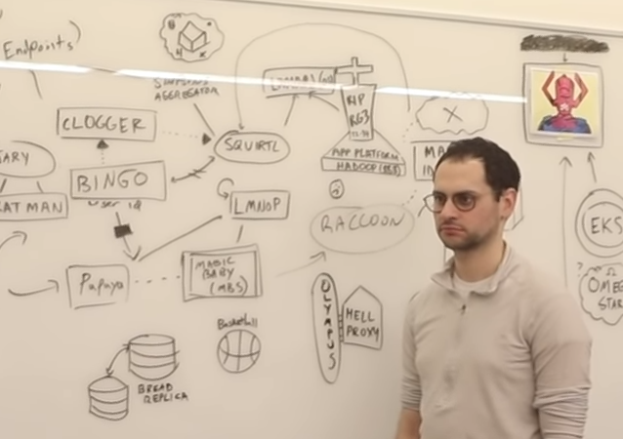
Complicated Architecture?
https://www.youtube.com/watch?v=y8OnoxKotPQ
Notes:
A short video you can check out. It’s obviously comedic and satirical but is still deeply rooted in reality - as previously mentioned, web systems can get complicated, fast.

Slide 23
Overall Picture (again)
Request
Front-end
via HTTP
REST API
Back-end
Response
HTML/CSS/JS
Java, or C, or JavaScript, etc..
Notes:
For now, understanding the simple client/server model is enough to get you on your feet. Don’t worry too much about the less trivial stuff if it wasn’t making sense, you’ll get it in time.

Slide 24
Some Resources
Check out some of the following resources to aide your learning:
https://en.wikipedia.org/wiki/Hypertext_Transfer_Protocol https://en.wikipedia.org/wiki/Query_string https://www.restapitutorial.com/lessons/restquicktips.html https://www.youtube.com/playlist?list=PLMCXHnjXnTnvo6alSjVkgxV-VH6EPyvoX

Slide 25
Kahoot!
Time for a quiz. Prizes up for grabs!
Join at: www.kahoot.it
Wait for the game-pin to come up on screen.

Slide 26
Practical time!
What you’ll be doing
Live coding a Recipe app! - Build the front-end in HTML/CSS/JS - Build the back-end in JavaScript (with the Node.js engine)
Learn how to create a REST API
Learn how to create a usable front-end
Tie the two together using HTTP requests

